Slide 1
SS ZG 526: Distributed Computing
Introduction: Part 2
Chittaranjan Hota
Professor, Dept. of Computer Sc. & Information Systems
BITS, Pilani Hyderabad Campus, Hyderabad
hota@hyderabad.bits-pilani.ac.in

Slide 2
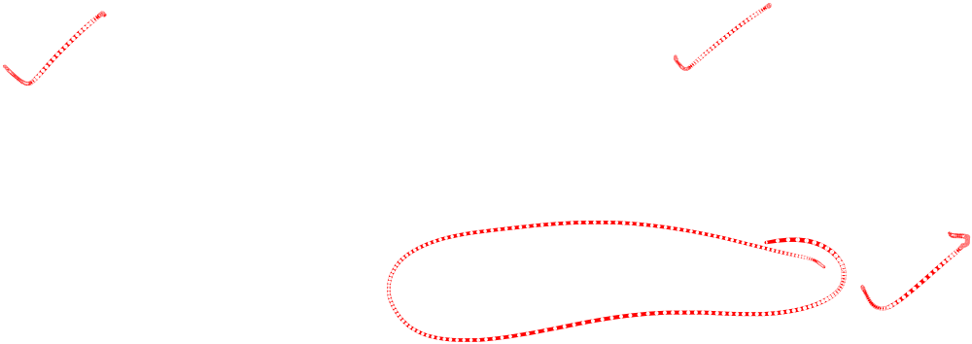
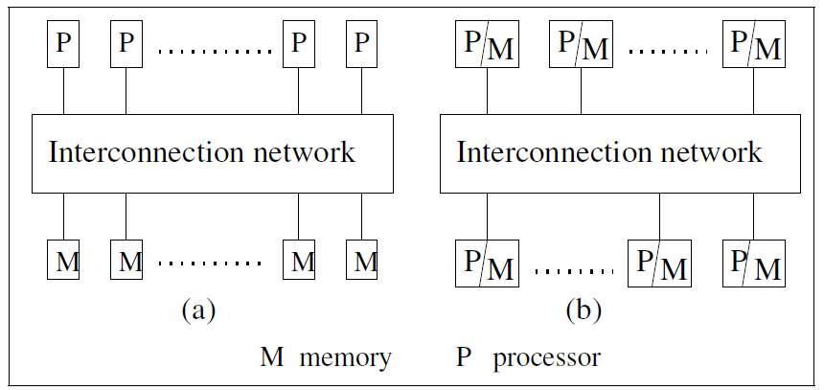
Multiprocessor Vs Multi-computer systems
Birla Institute of Technology and Science, Pilani (Deemed University)

Slide 3
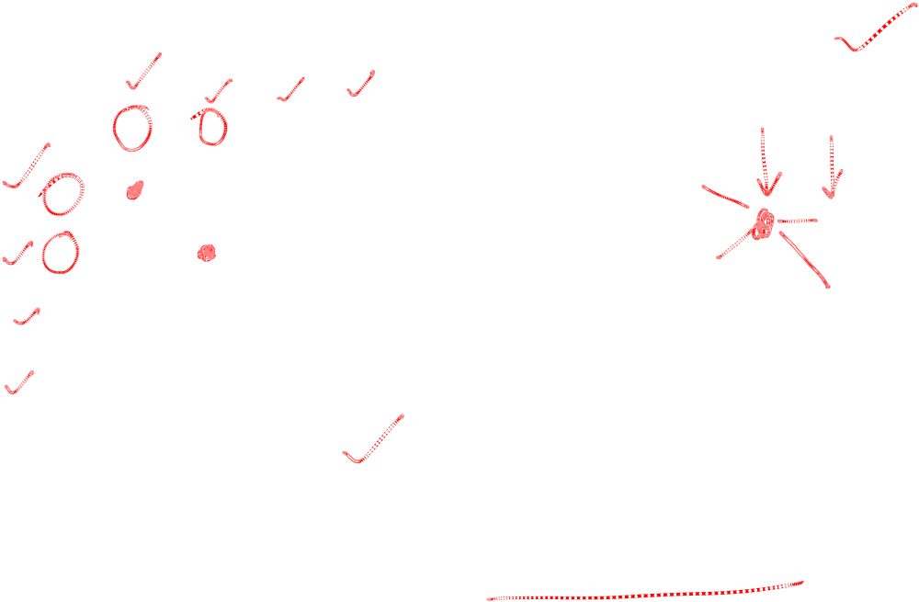
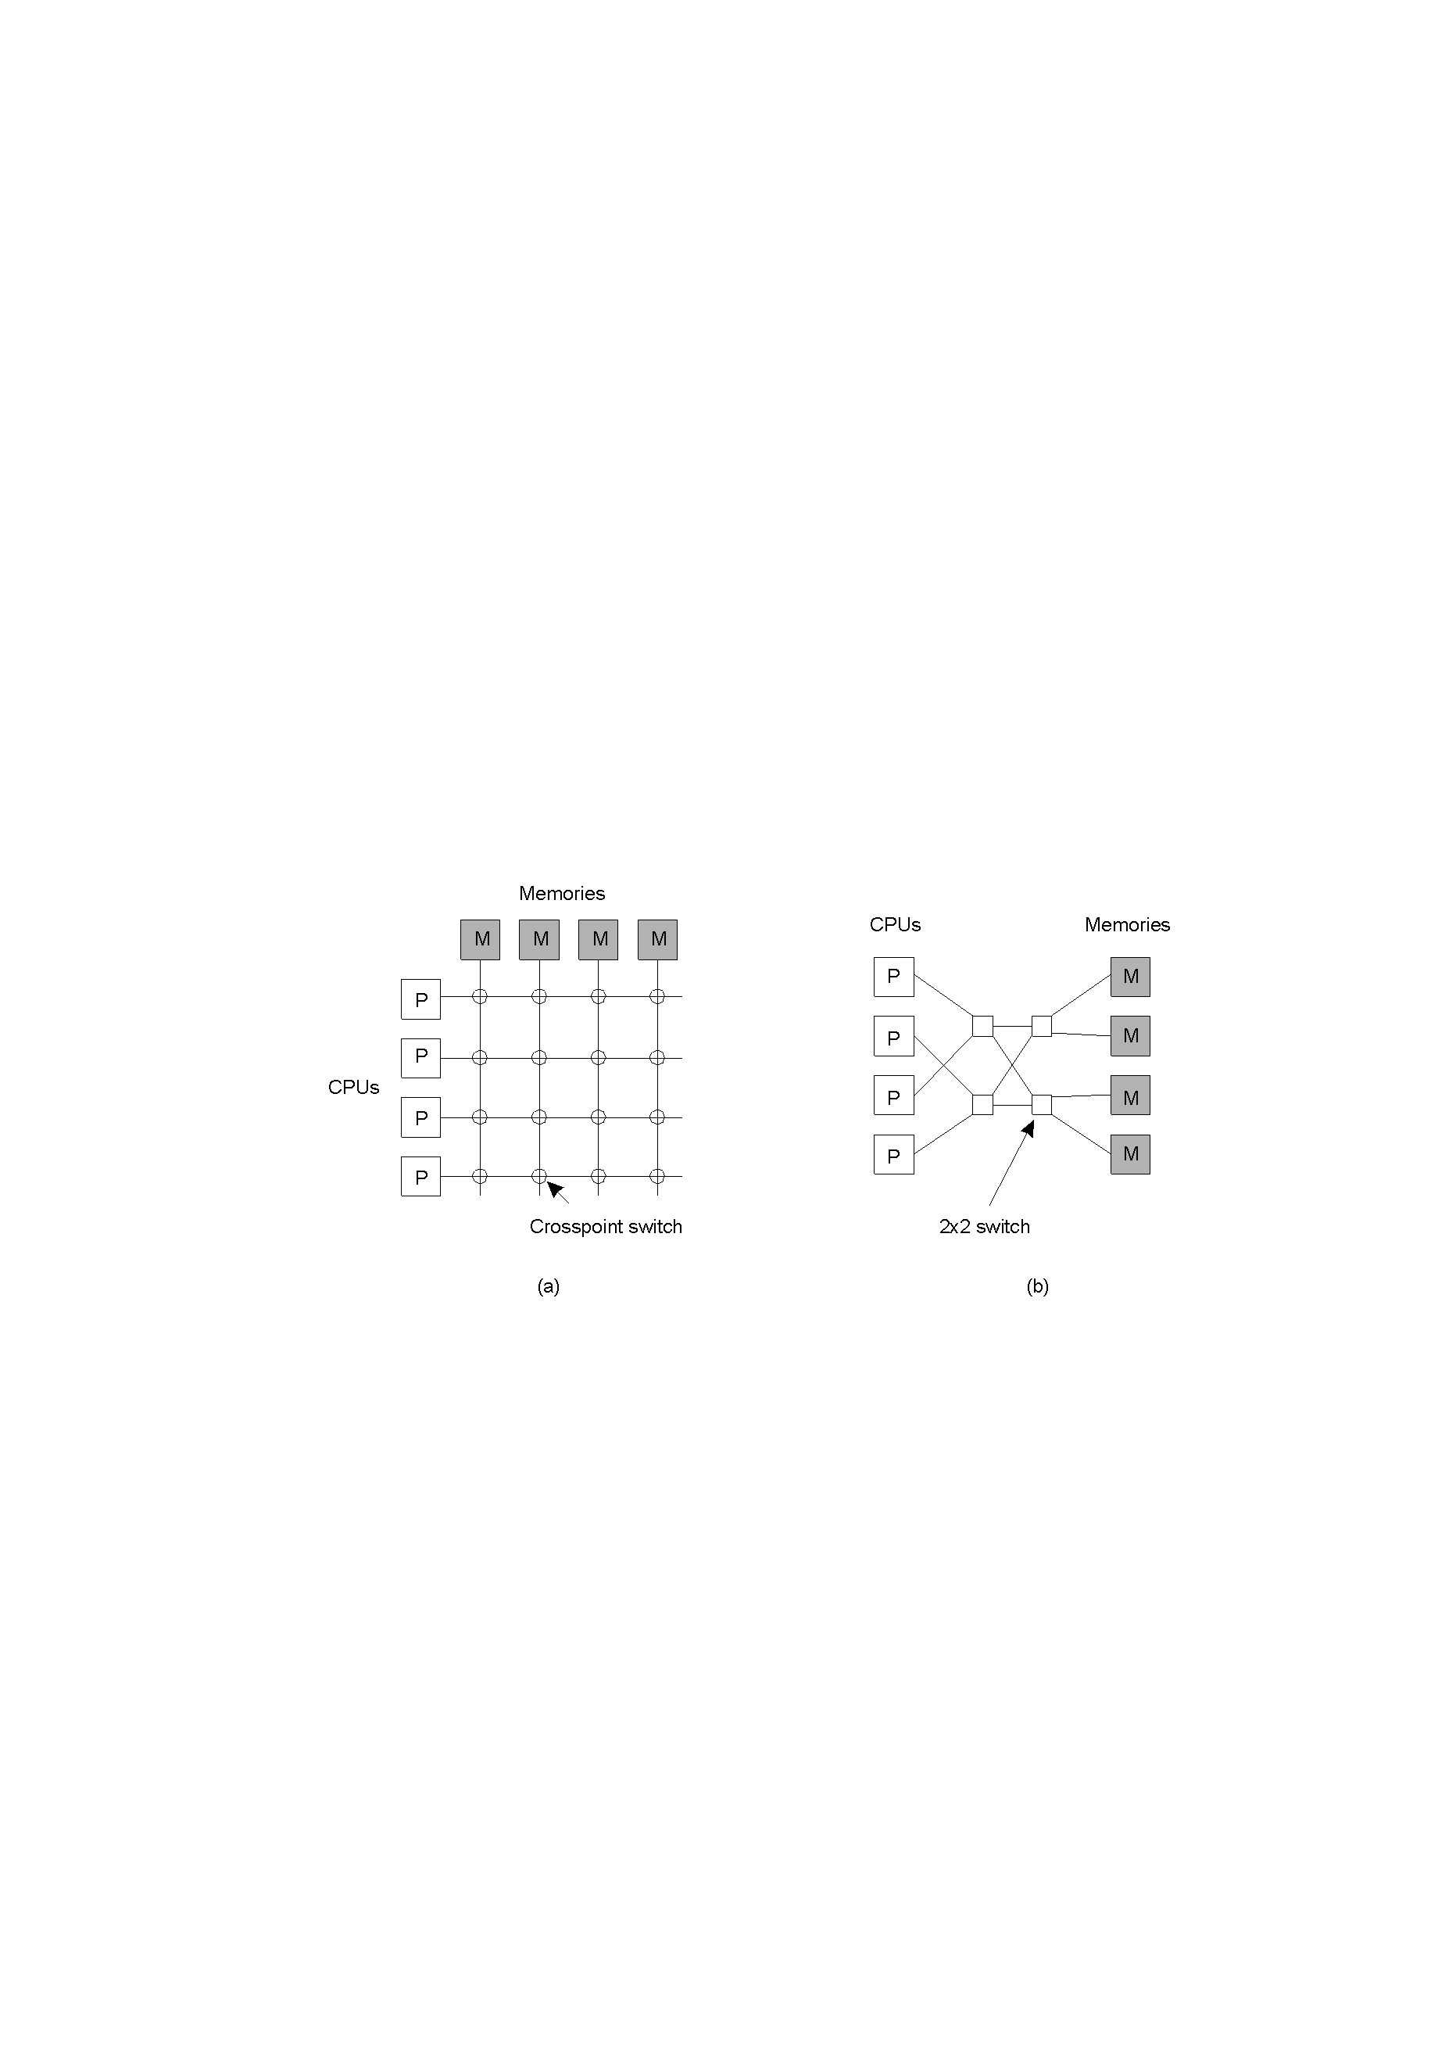
Multiprocessors
A crossbar switch, b) An omega switching network
Birla Institute of Technology and Science, Pilani (Deemed University)

Slide 4
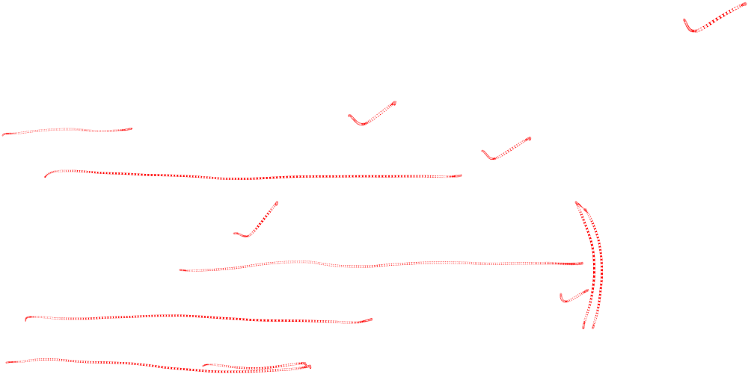
Distributed Systems: Pros and Cons
Advantages
  Communication and resource sharing possible
  Economy : Price-performance
  Reliability & scalability
  Potential for incremental growth
Disadvantages
  Distribution-aware OSs and applications
  High network connectivity is essential
  Security and privacy
Birla Institute of Technology and Science, Pilani (Deemed University)

Slide 5
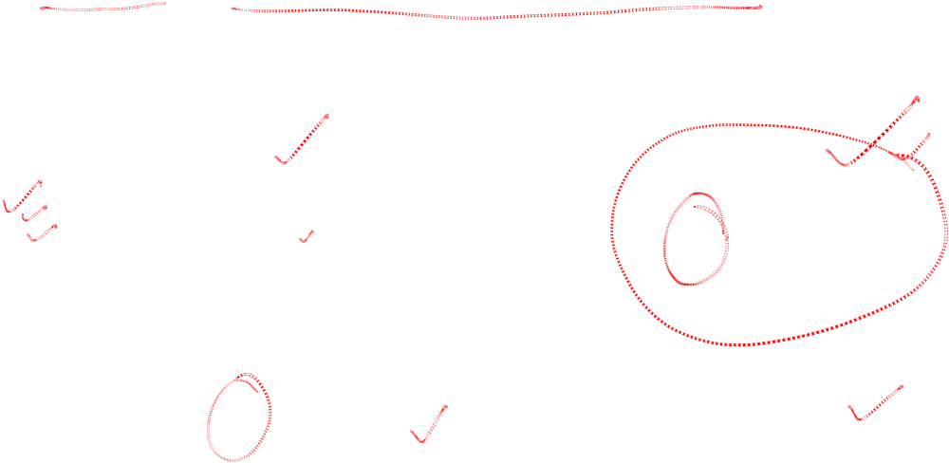
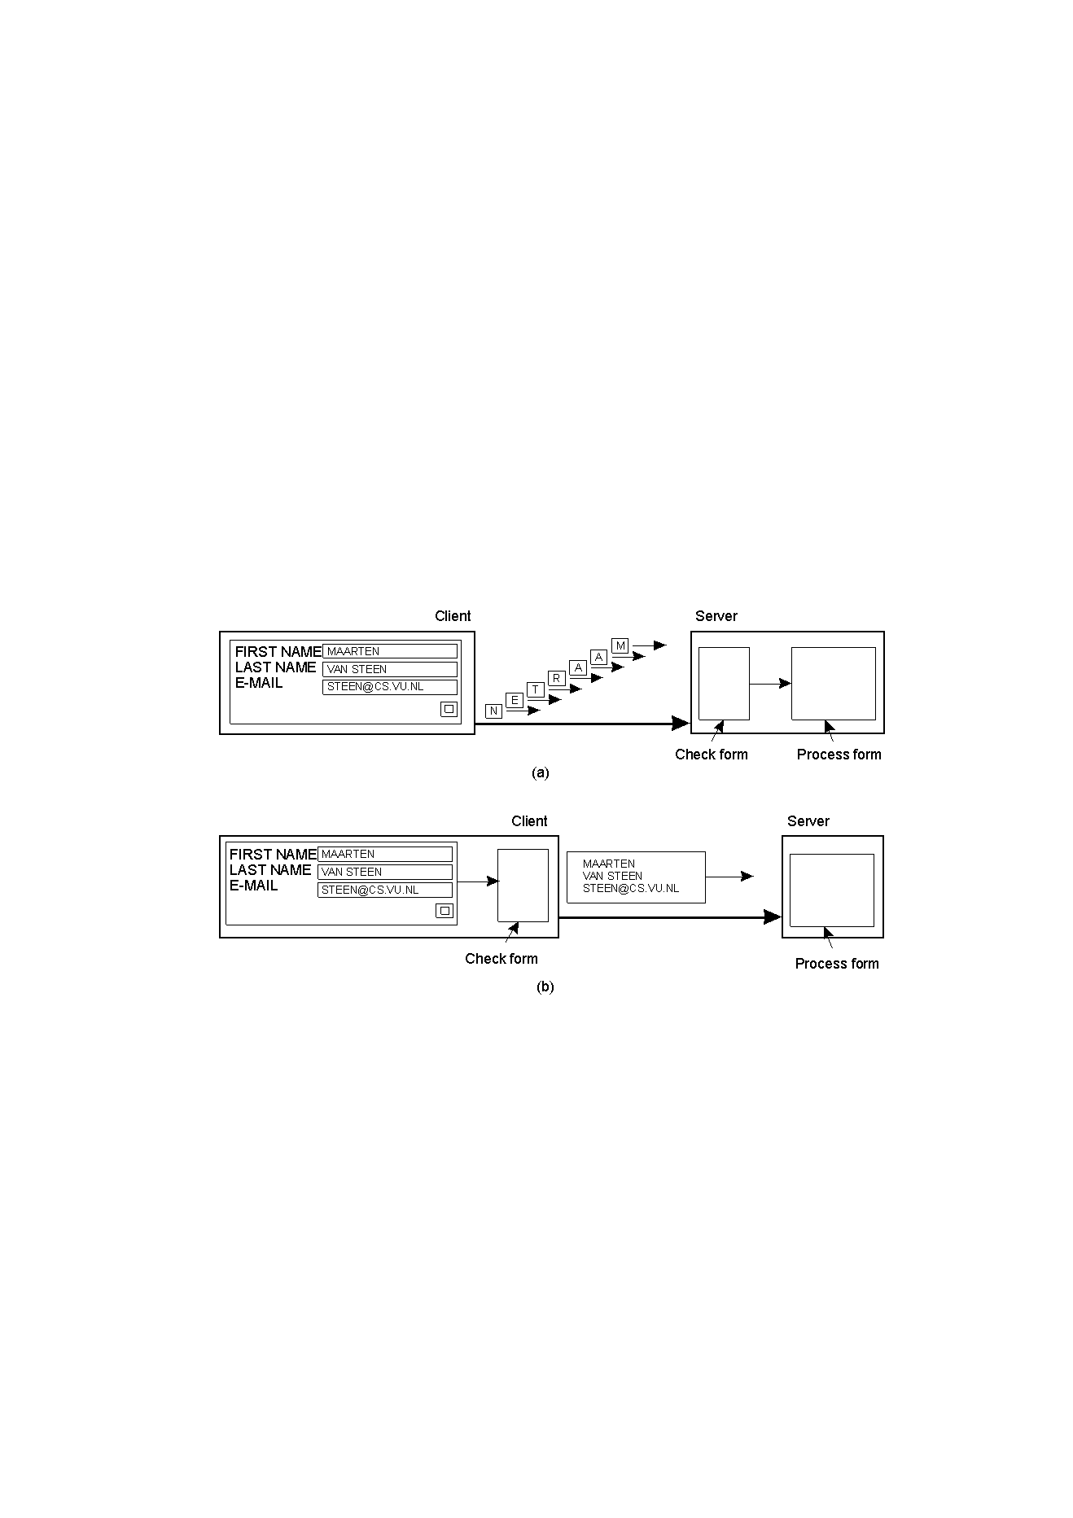
Design Issues: Scaling
If possible, do asynchronous communication
  Not always possible if the client has nothing to do
Alternatively, by moving part of the computation
Technique (1): Hiding latency
Birla Institute of Technology and Science, Pilani (Deemed University)

Slide 6
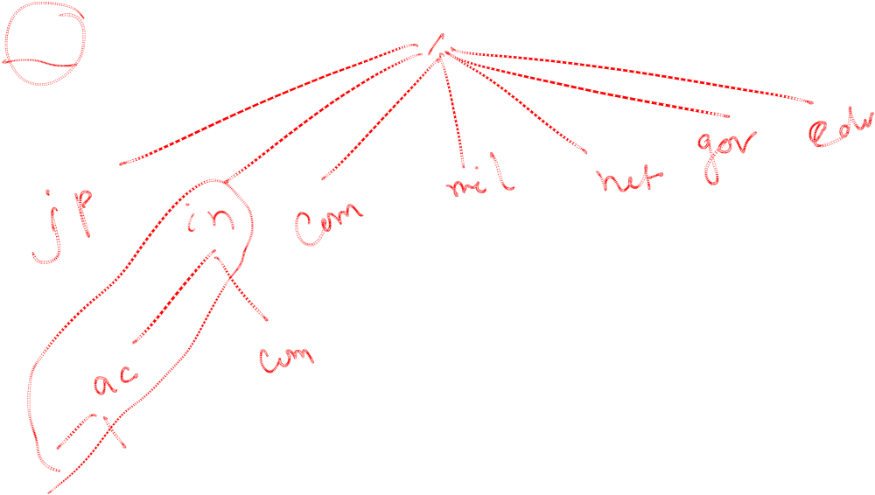
Scaling Technique (2): Distribution aware
Examples: DNS resolutions
Birla Institute of Technology and Science, Pilani (Deemed University)

Slide 7

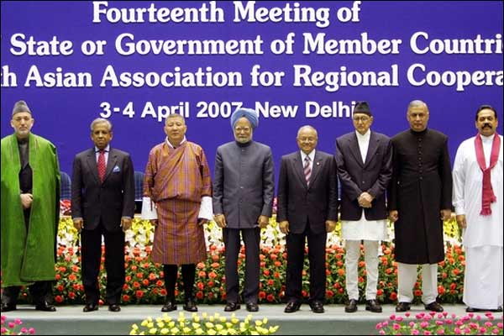
More Design Issues
Lack of Global Knowledge
Naming
Compatibility
Process Synchronization
Resource Management
Security
Image source: www.bbc.co.uk
Birla Institute of Technology and Science, Pilani (Deemed University)

Slide 8
Next session
Distributed Communication models
Birla Institute of Technology and Science, Pilani (Deemed University)

